Slide 1
Mid-Day Meal Scheme
Chandigarh Administration
PAB Meeting on 07.06.2018

Slide 2
Schools Covered Under MDMS
No. of schools Enrolment as on 30.9.2017
Primary U. Primary
Govt. : 113 53078 41732
Govt. Aided : 06 1791 1630
Madarasa : 04 351 172
Total : 55220 43534
Grand Total : 98754
Besides this, Education Department provides MDM to 7829 Pre-Primary students from UT Budget.

Slide 3
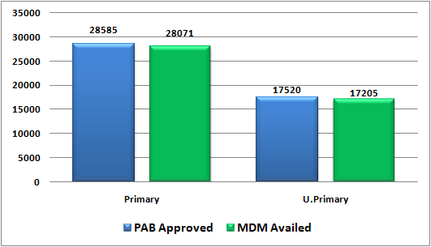
Coverage of Children
During the year 2017-18
Institutions | PAB Approval | Availed MDM | % Coverage
Primary | 28585 | 28071 | 98
Upper Primary | 17520 | 17205 | 98
Total | 46105 | 45276 | 98

Slide 4
Percentage of MDM coverage in Urban/Rural Area Schools
During the year 2017-18
 | Urban | Rural | Total
Schools | 86 | 37 | 123
Per day Meals received | 24281 | 20995 | 45276
Percentage | 54% | 46% | 100%
Main reason for less coverage of children is that majority of children studying in urban area schools belong to service class families who mostly bring their own Tiffin and their intake capacity of food is also less.

Slide 5
Per Meal Cooking Cost 2017-18
Fixed by GOI | Centre Share (100% as per norms) | Actual Avg. Per Meal Cooking Cost | Additional Support from State Budget (Col 3-2)
1 | 2 | 3 | 4
Rs. 4.13 (Pry.) Rs. 6.18 (U. Pry.) | Rs. 4.13 (Pry.) Rs. 6.18 (U. Pry.) | Rs 7.08* (Pry.) Rs. 9.59* (U. Pry.) | Rs. 2.95 (Pry.) Rs. 3.41 (U. Pry.)
* Includes Cost of Vegetables, Oils and Fats, Salt and Condiments, Fuel and labour & others overhead charges claimed by centralized institute excluding the cost of food-grains.

Slide 6
Weekly MDM Menu/Cooking Cost
 | Prantha Based From AIHM-42 | Rice Based From CITCO-17 | Veg. Pulao Based From CIHM-42
Monday | Prantha + Rajmah | Veg. Pulao + Dal Chana | Veg. Pulao +Dal Arhar
Tuesday | Prantha+ Karhi Pakora | Veg. Pulao + Karhi with veg. Pakora | Veg. Pulao + Karhi Nutri
Wednesday | Prantha+Dal Chana+ Veg. | Veg. Pulao + Dal Chana | Veg. Pulao + Mix Dal
Thursday | Prantha + Rajmah | Veg. Pulao + Rajmah | Veg. Pulao + Rajmah
Friday | Prantha+ Karhi Pakora | Veg. Pulao + Karhi with veg. Pakora | Veg. Pulao + Karhi pakora
Saturday | Prantha + Mix Dal | Veg. Pulao + Rajmah | Veg. Pulao + Nutri Aalo Mattar
Per Meal Rate | Rs. 8.94 (Both for Primary & U. Primary) | Rs. 7.20 for Primary Rs. 9.17 for U. Primary | Rs. 7.20 and Rs.0.61 additional for Nutri (2 Days) for Primary Rs. 9.17 and Rs.0.72 additional for Nutri (2 Days) for U. Primary

Slide 7
Food Grains Utilization During the year 2017-18 (Qty. in MTs)
 | Opening Balance | Released/Lifted from FCI | Total | Consumed during the year | Closing Balance | % of Utilization
Rice & Wheat | 144.09 | 663.90 | 807.99 | 748.95 | 59.04 | 92.69 %
Foodgrain approved by Govt. of India 1261.88 MT as per following norms for 46105 meals per day :
Foodgrains Norms – 100 gms for Primary and 150 gms for U. Primary
Allocation for Primary – 28585*0.100 gms*230 days = 657.44 MT
Allocation for U. Pry – 17520*0.150 gms*230 days = 604.44 MT

Slide 8
Payment of Bills of Food Grains to FCI
During the year 2017-18 (Figures in Lakh)
Food Grains for Both Primary & U. Primary | Funds Released by GOI | Bills received from FCI | Payment made to FCI | Outstanding Payment of FCI | Closing Balance
Rice & Wheat | 30.41 | 21.78 | 21.78 | Nil | 8.63
Rs. 34.45 Lakh were approved by GOI to lift the 1261.88 MT of foodgrains from FCI @ Rs. 2000/- per MT for Wheat and Rs. 3000/- per MT for Rice

Slide 9
Budget Utilization
During the year 2017-18
(In Lakh)
Total Budget Allocation | Centre Share (100% as per Norms) | UT Provision (Addl) | Utilization up-to 31.03.2018 | % Utilization
1250.47 | 674.47 | 576.00 | 1231.10 | 98.45

Slide 10
Component wise Budget Utilization
(In Lakh)
Component | Allocation 2017-18 |  |  | Utilization 2017-18 |  | % Utilization
 | Centre Share | UT Share | UT Provision (Addl) | Centre | UT | Centre | UT Share
Cost of Food-grains | 34.45 | 0 | 0 | 21.78 | 0 | 63.22 | 0
Cooking cost | 520.56 | 0 | 349.82 | 520.09 | 349.82 | 99.91 | 100.00
Honorarium of CCH | 80.00 | 0 | 128.25 | 79.07 | 128.25 | 98.83 | 100.00
Transportation Assistance | 9.46 | 0 | 53.28 | 4.16 | 53.28 | 43.97 | 100.00
Monitoring Management, and Evaluation (MME) | 30.00 | 0 | 44.65 | 30.00 | 44.65 | 100.00 | 100.00
Total | 674.47 | 0 | 576.00 | 655.10 | 576.00 | 97.13 | 100.00

Slide 11
Budget proposed for 2018-19
(Figures in Lakh)
 | Centre Share (100% as per norms) | UT Provision (Additional) | Total
Primary | 396.09 | 415.51 | 811.60
U. Primary | 341.90 | 255.86 | 597.76
Total | 737.99 | 671.37 | 1409.36

Slide 12
Component wise Proposed Budget for 2018-19
(Figures in Lakh)
Component | Centre Share |  |  | UT Share
 | Primary | Upper Primary | Total | Primary | Upper Primary | Total
Cost of Food Grain | 17.94 | 17.94 | 35.88 | - | - | -
Cooking Cost | 284.97 | 284.28 | 569.25 | 203.55 | 156.86 | 360.41
Transportation Assistance | 5.18 | 5.18 | 10.36 | 46.00 | 30.00 | 76.00
Honorarium to Cook cum Helpers | 48.00 | 34.50 | 82.50 | 96.00 | 69.00 | 165.00
Monitoring Management and Evaluation (MME) | 40.00 | 0 | 40.00 | 69.96 | 0 | 69.96
Total | 396.09 | 341.90 | 737.99 | 415.51 | 255.86 | 671.37
Cost of Foodgrains, Cooking Cost, Transportation Assistance has been proposed for 30000 Primary Students and 20000 U. Primary Students for 230 Days as per norms fixed by the GOI in respect of Central Assistance. However, honorarium of CCH has been proposed for 825 Cook-cum-helpers against the previous year approval of 800.

Slide 13
Components wise Proposed MME
Components | Amount in Lakh
Salary of Existing Manpower | 77.96
Transport & Conveyance | 3.00
Office Expenditure | 3.00
Purchase of required Furniture, Computer Hardware and Accessories | 5.00
Testing of cooked Food & Foodgrains samples of MDM | 3.00
Fortification of Foodgrains | 5.00
Expenditure on Automated Monitoring System | 2.00
School Level Expenses | 11.00
Total (Rs. 40 Lakh from Central Assistance & Rs. 69.96 from State Budget | 109.96
Detail of Salary of Existing Manpower
Office Incharge – 1 @ Rs.3.71 Lakh, Office Assistant – 1 @ Rs.2.53 Lakh, Clerk – 1 @ Rs. 2.45 Lakh, MIS Coordinator – 1 @ Rs.5.05 Lakh, Data Entry Operator – 1 @ Rs.2.45, Inspector – 3 @ Rs. 1.65 Lakh, Supervisors – 20 @ Rs. 0.99 Lakh, Organizers – 7 @ Rs.0.94 Lakh, Professional Cooks – 7 @ Rs. 0.94 Lakh, Helpers – 6 @ Rs. 1.68 Lakh

Slide 14
Data Entry Status under MDM-MIS Portal
&
Status of Automated Monitoring System
Annual Data Entry : 100 %
Monthly Data Entry : 100 %
Health Data Entry : 100 %
SMS based Automated Monitoring System (AMS) has been implemented successfully in UT Chandigarh through NIC Chandigarh (Adopted the Model of NIC HP)

Slide 15
Coverage under Rashtriya Bal Swasthya Karyakram (RBSK-School Health Programme) During the year 2017-18
Components | No. of Children Covered
Health Checkup (Recording of Height & Weight etc.) | 88227
Coverage under Weekly Iron Folic Acid Supplement (Distribution of Iron Folic Acid & De-worming medicine) | 125823
Spectacles Distributed | 590
Number of visits made by RBSK team - 1359

Slide 16
Best/Innovative Practices
School Cluster Kitchens have setup their kitchen gardens for fresh vegetables.
CCTV Cameras are installed in all MDM kitchens.
Honorarium to Cook-cum-helpers increased from Rs. 2622/- to Rs. 3000/-.
Fortified Wheat Flour is used for preparation of MDM.
Three Mixture/Blenders donated by NGO (PATH) installed for fortification of Rice.
Compost is prepared from the Kitchen waste.
MDM is monitored by PCS/HCS Officers in addition to by the Officers of the Education Department.
MDM is cooked by the professionals of Hotel Management Cooking Institutes.
Additional fund support by the Chandigarh Administration of Rs. 576 Lakh during the year 2017-18.

Slide 17
Process

Slide 18
Mid Day Meal Kitchens
In order to provide hot cooked and nutritious food is served to eligible students and to ensure good quality and hygiene, Chandigarh Administration has engaged 3 reputed cooking institutes :-
Dr. Ambedkar Institute of Hotel Management, Sector-42, Chandigarh.
Chandigarh Institute of Hotel Management, Sector-42, Chandigarh.
Chandigarh Industrial & Tourism Corporation (CITCO), Sector-17, Chandigarh.
Besides this, 7 Cluster based kitchens located at GMSSS-10, 15, 26, 44, 47 and GMHS-38 & 42 are also cooked food for 31 school children.
There is also a proposal to construct 3 more Cluster based kitchens at GMSSS-23A, GMSSS-40 & GMHS-29.

Slide 19
Inspection of Food-grains
A committee of the following is constituted for inspection of food-grains at FCI Godowns before lifting food-grain.
1. The District Education Officer
2. The Director Health Services
3. The District Food & Supply Officer
4. Nominated Principal of Govt. Sr. Sec. Schools
5. Representative of FCI

Slide 20
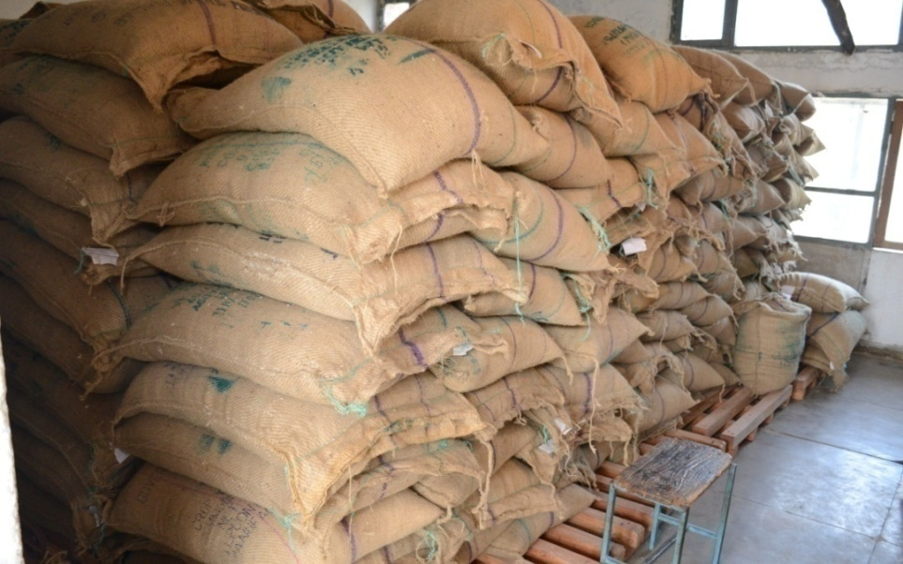
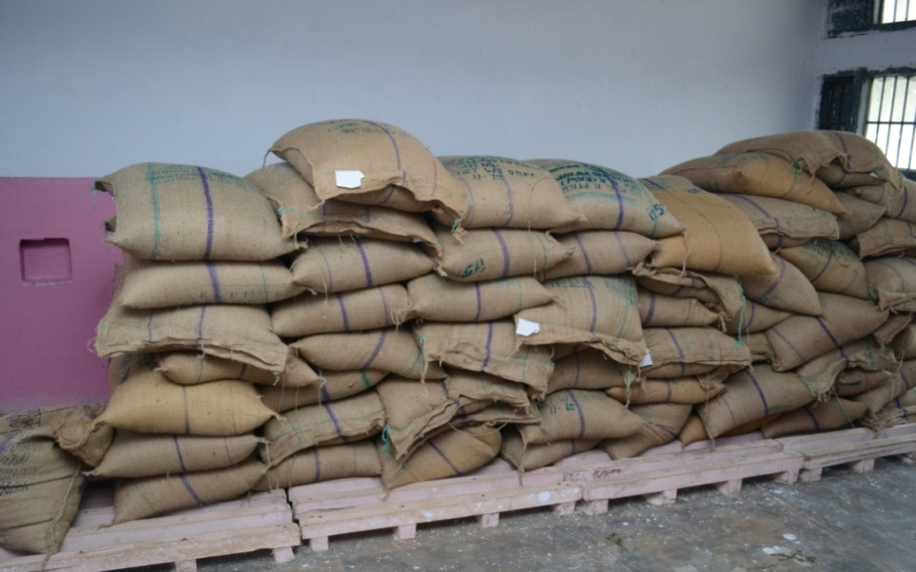
STORAGE OF FOOD GRAINS
Food grains are lifted from the FCI Godowns as per requirement on monthly basis.
Wheat – is stored at the departmental store and from there sent to Flour Mill for grinding purposes. Atta is distributed to cooking institutes/schools as per their requirements.
Rice – is stored at the departmental stores and is distributed to cooking institutes/schools as per their requirements.

Slide 21
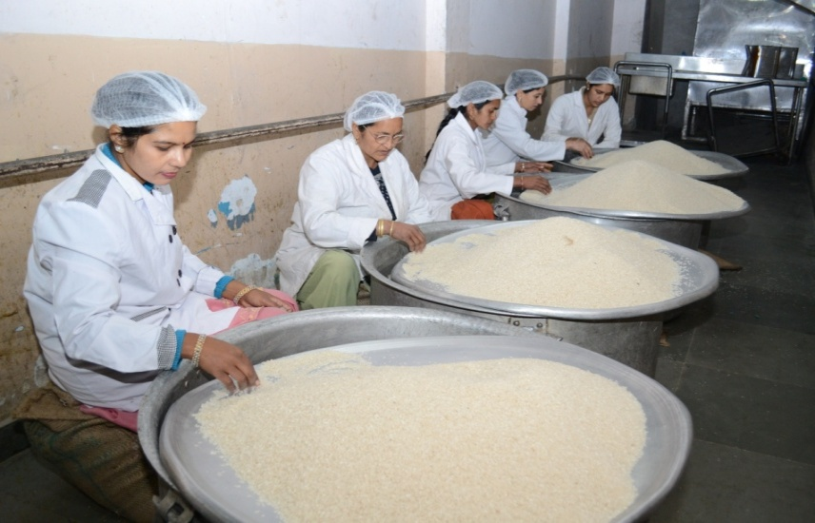
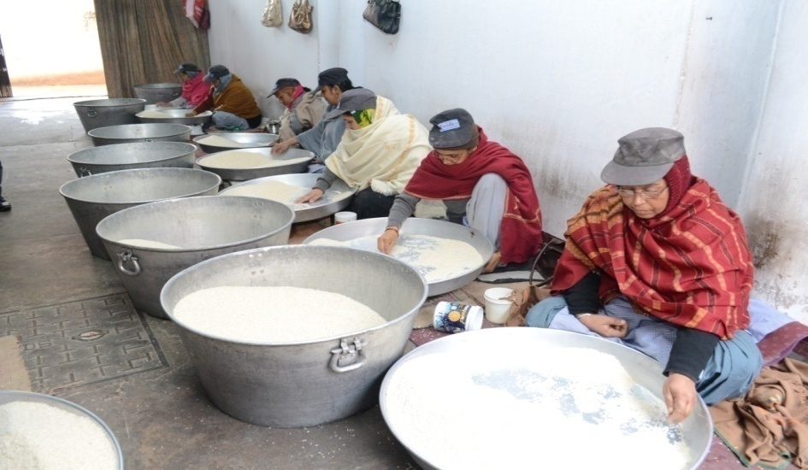
Cleaning of Grains

Slide 22
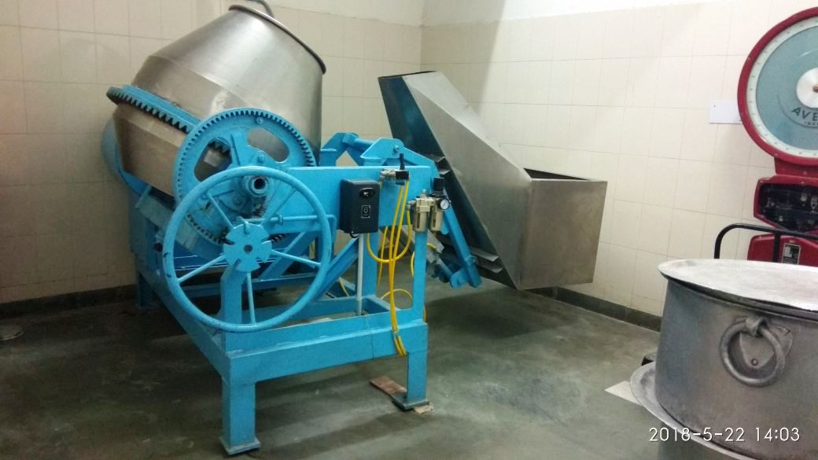
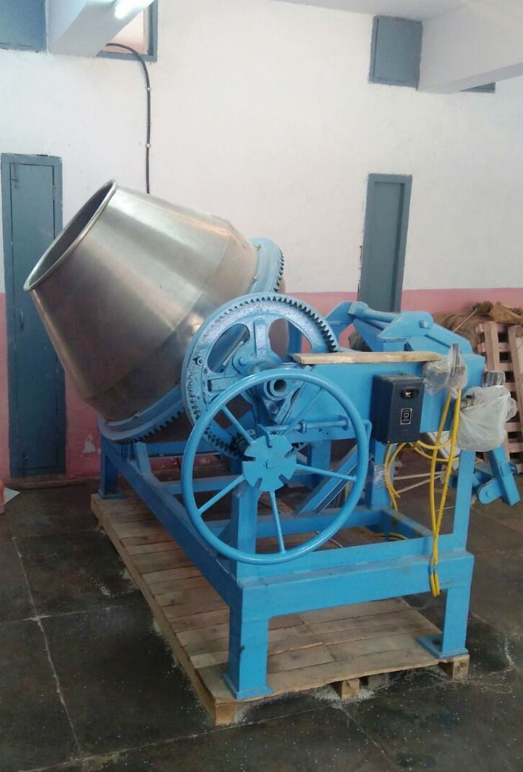
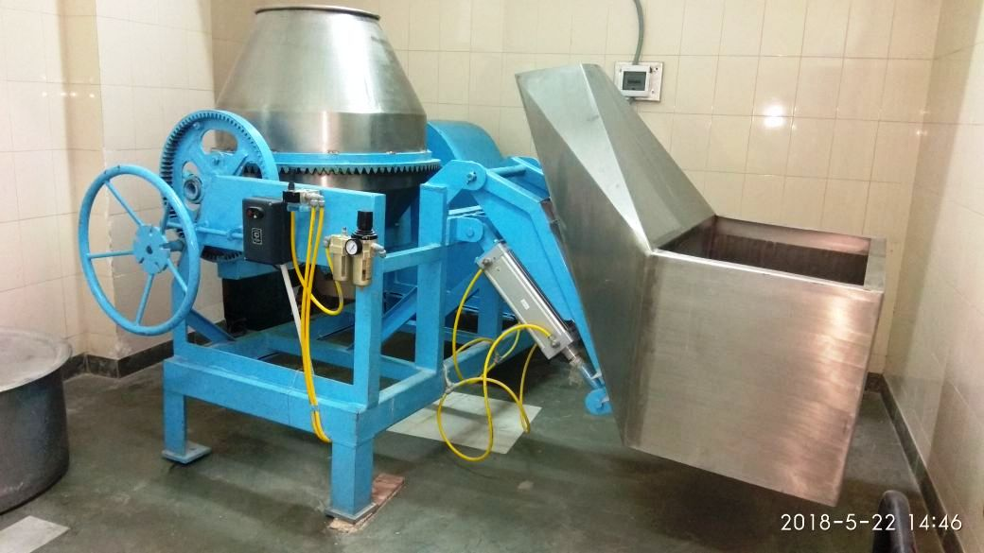
Mixture/Blender for Fortification of Rice

Slide 23
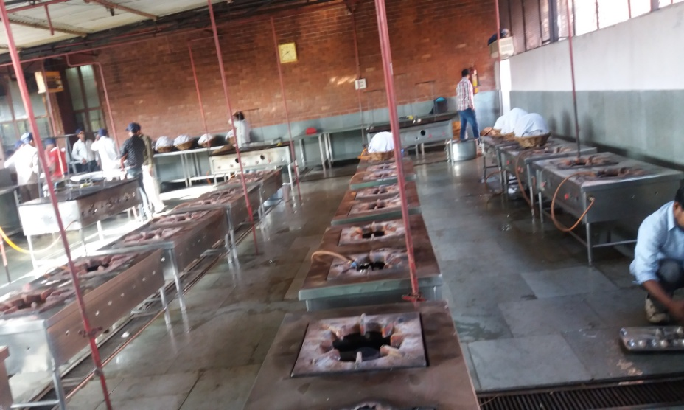
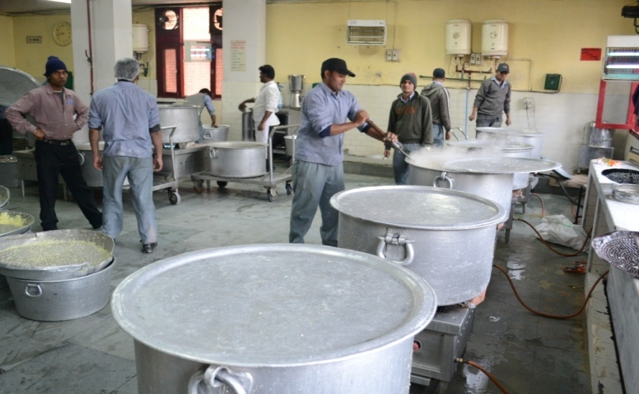
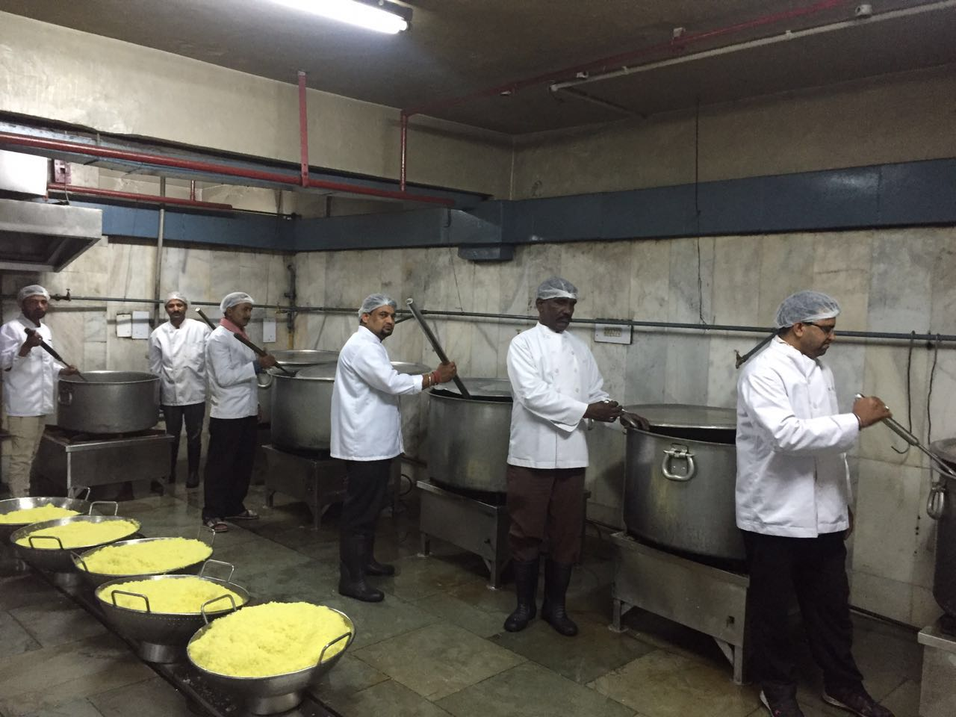
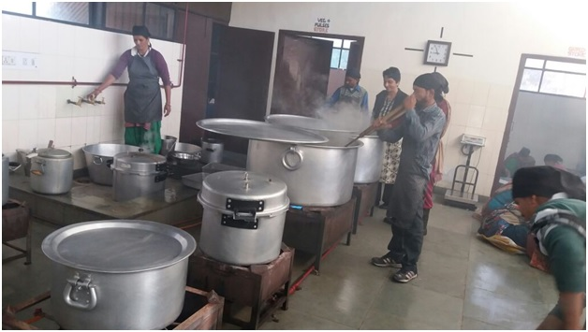
Centralized Kitchens at a Glance
AIHM-42 CIHM-42
CITCO-17 School Based Kitchen -GMSSS-47

Slide 24
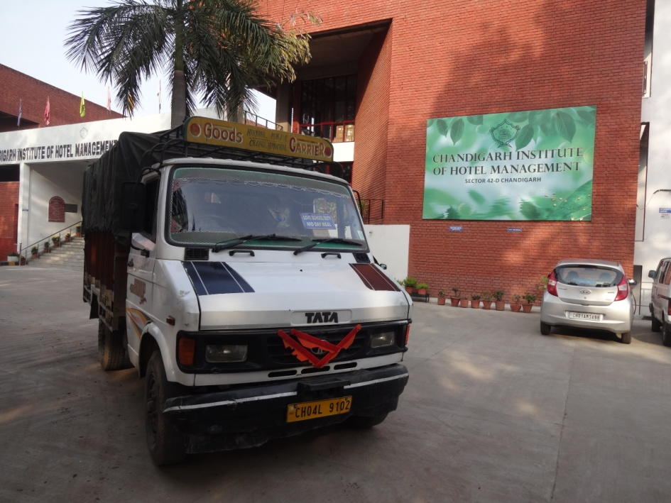
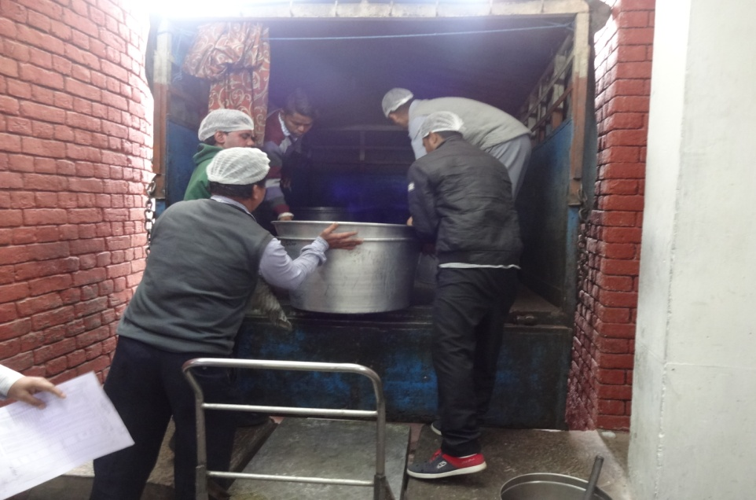
Transportation Arrangements
Food grains are transported by Big Trucks from FCI Godown to Departmental stores and from stores to cooking sites by Mini trucks.
Cooked meals are transported to schools by mini trucks.

Slide 25
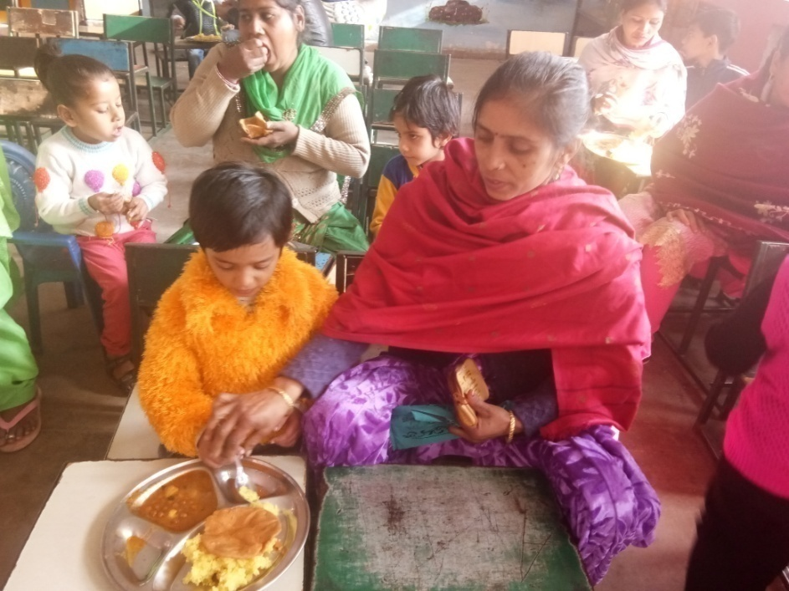
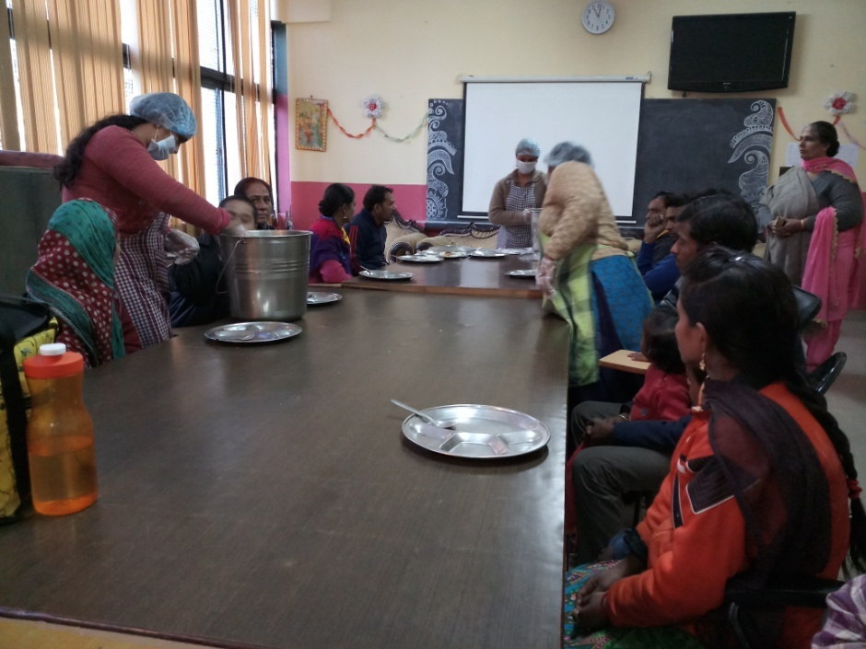
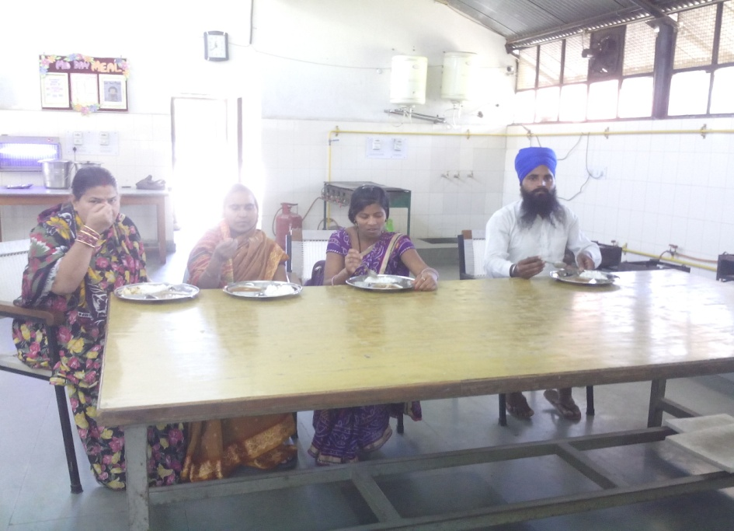
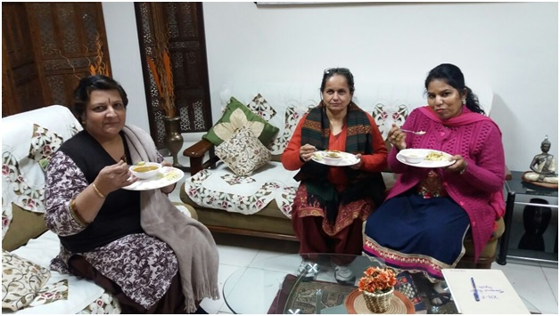
Tasting of meals by the Principal/SMC/Parents

Slide 26
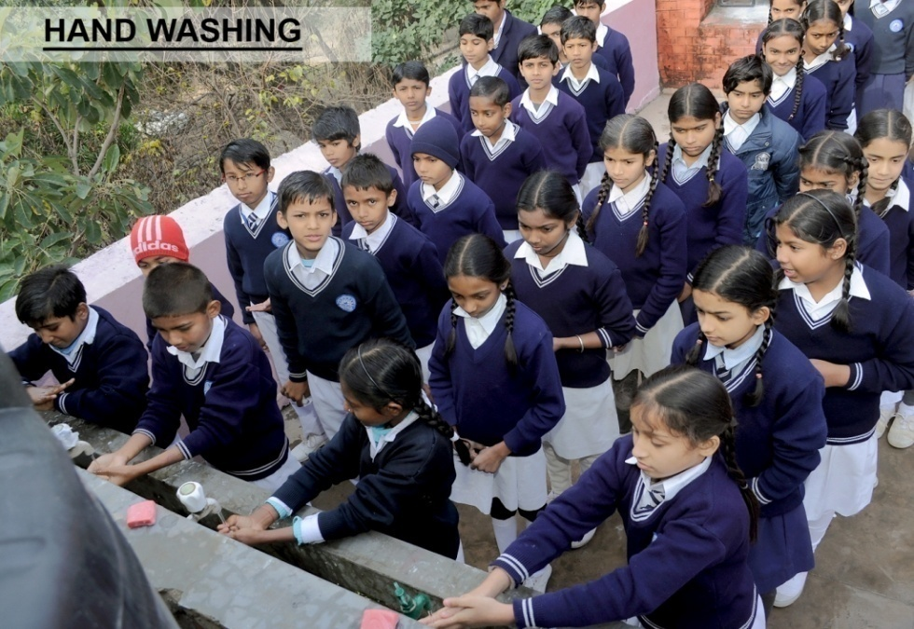
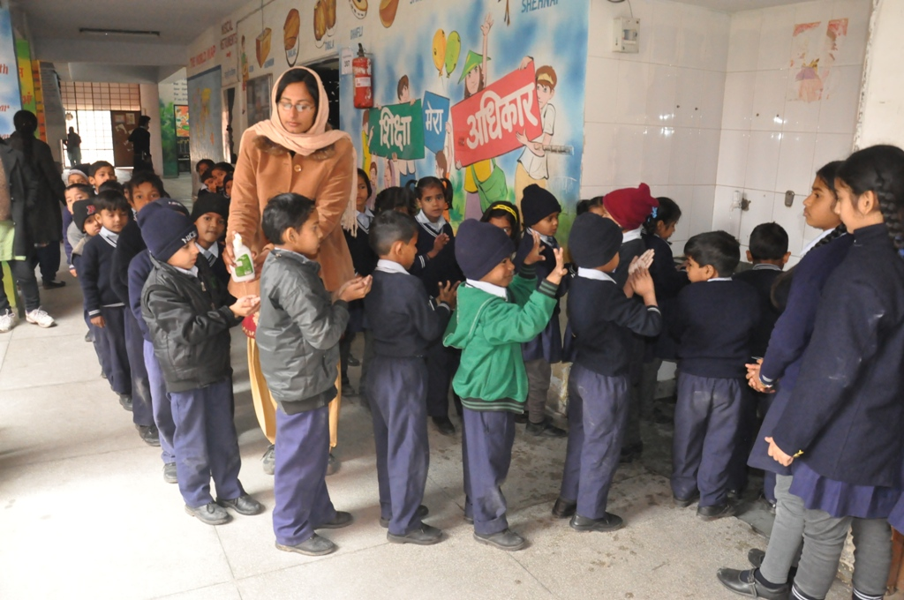
Hand Washing

Slide 27
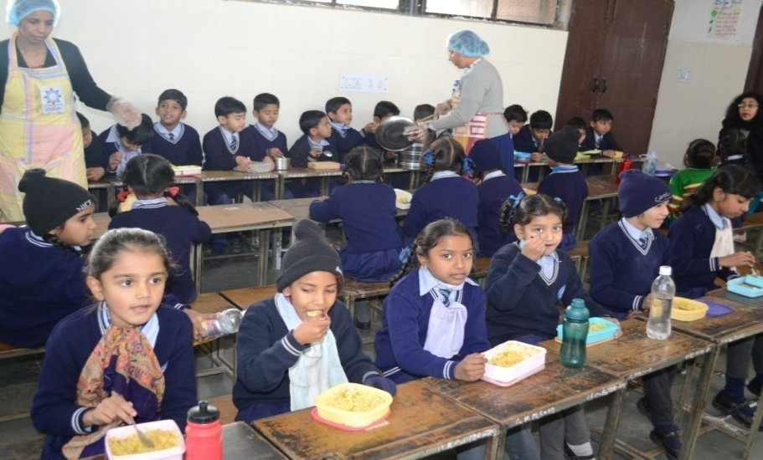
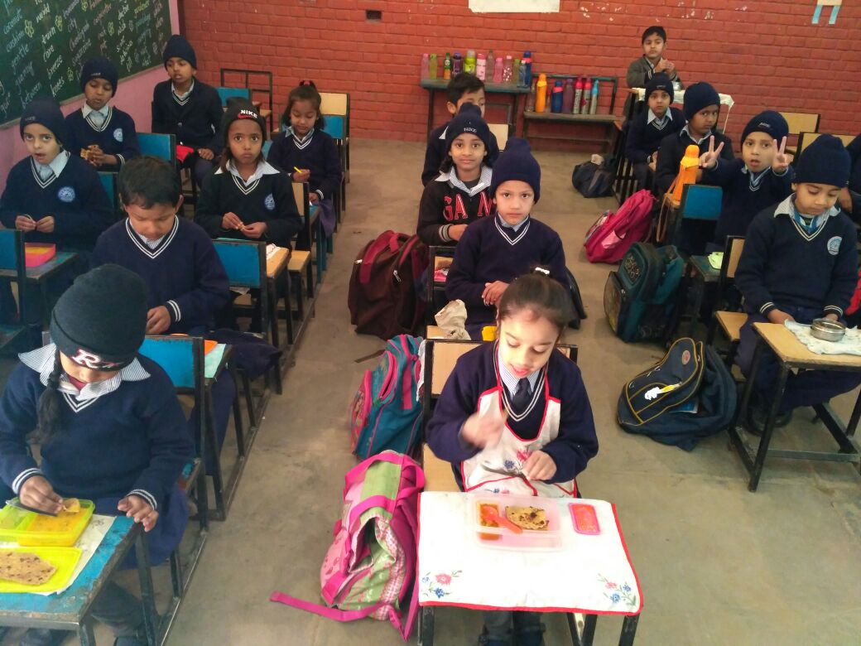
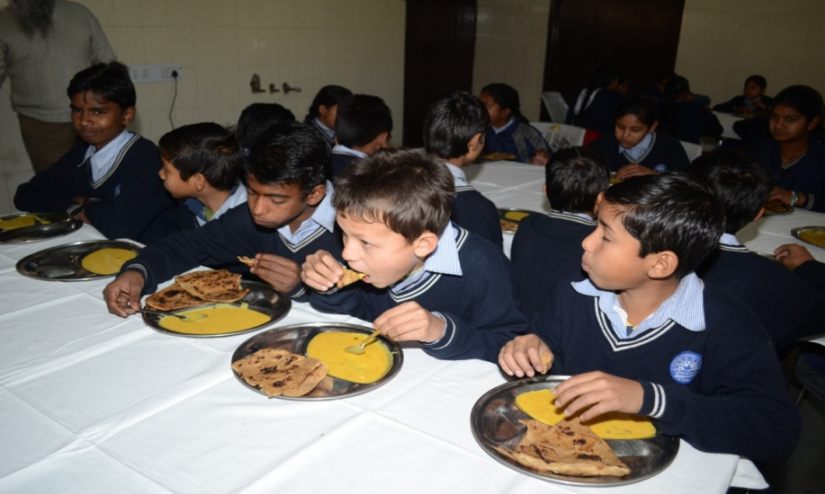
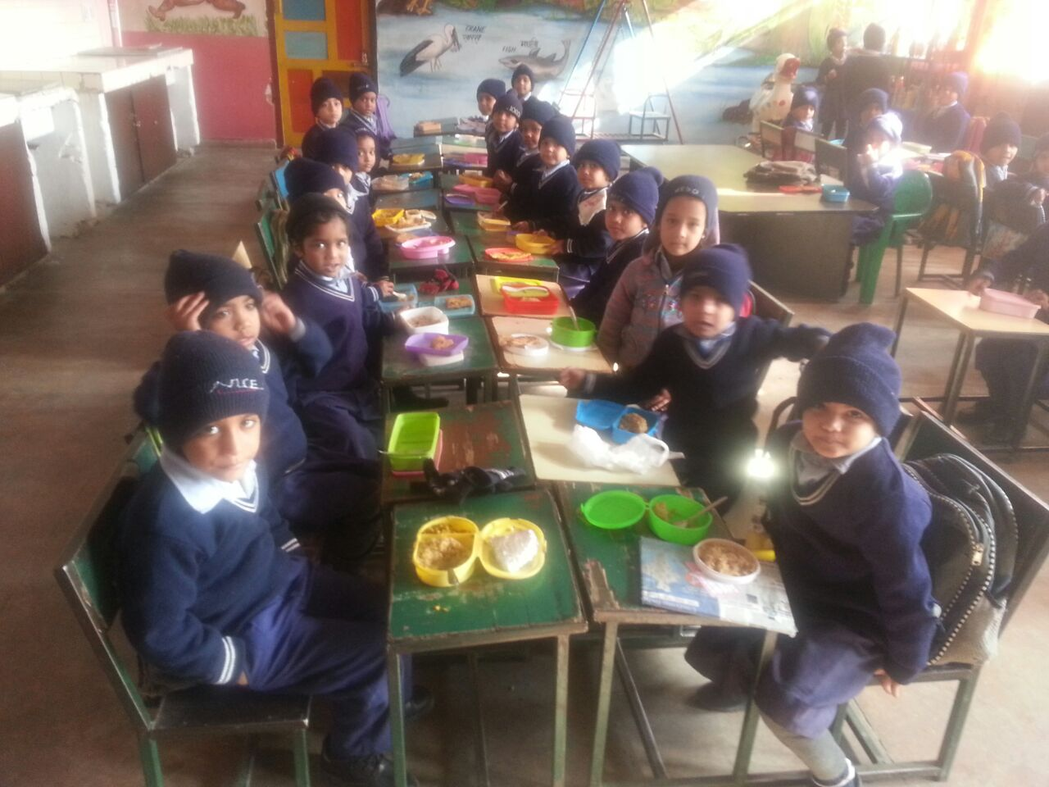
Distribution of meal in Schools

Slide 28
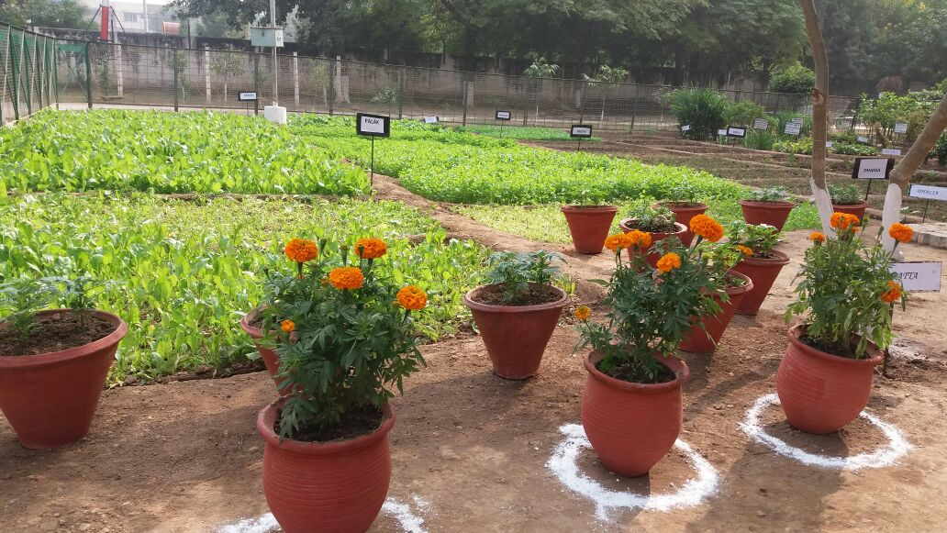
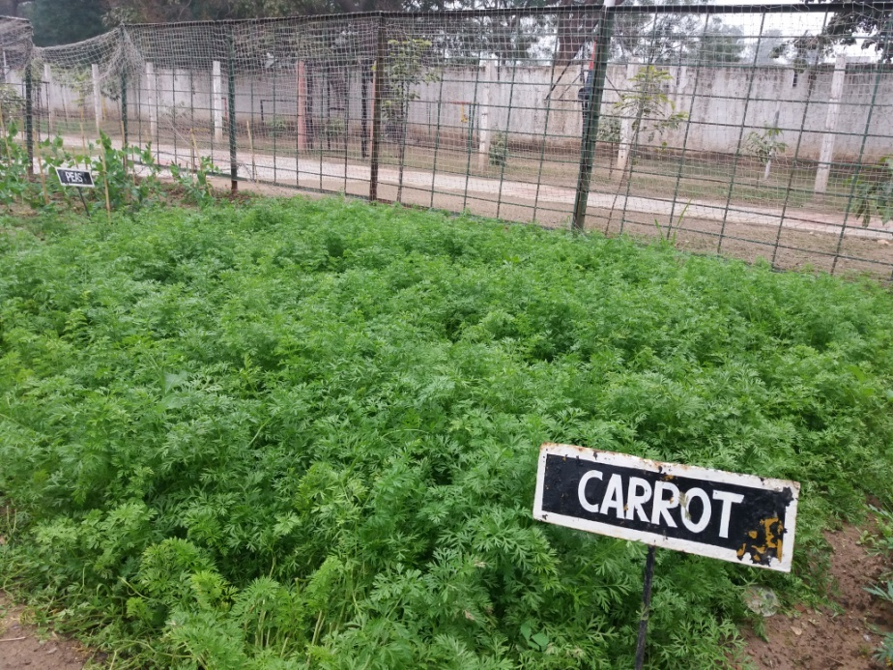
School Based Kitchen Gardening

Slide 29
Thanks

